Slide 1
Weather Forecasting
Alize serra açar

Slide 2
1.Gathering Data
We choosed our city to predict – its Adana where we live and where our school is located
And we used Microsoft Visual Crossing data for gathering our data.
We gathered our data monthly of 2020.
After then joined them with python language.

Slide 3
Attributes
Name –Nominal
Date – Nominal
Maximum Temperature
Minimum Temperature,
Temperature
Wind Chill
Heat Index
Precipitation
Snow
Snow Depth
Wind Speed
Wind Direction
Wind Gust
Visibility
Cloud Cover
Relative Humidity
Conditions-Nominal
Numeric

Slide 4
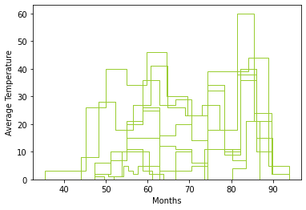
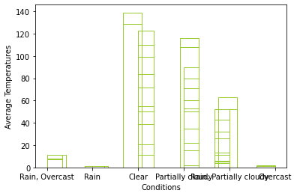

Slide 5
1.INTRODUCTION
In this project Adana’s weather conditions in 2021 were predicted using Adana’s weather data in 2020. We predict that machine learning (ML) and other data science techniques for predict.
Steps of the project
Gathering Data
Data Visualization
Preprocessing
Regression

Slide 6
Comparing the methods
Algorithm | Accuracy | Precision | Recall | F-Measure | ROC Area | RMSE
Linear Regression | %98 | - | - | - | - | 0.0913
Logistic | %70 | 0,730 | 0,7 | 0,714 | 0,854 | 0.3837
Simple Logistic | %90 | 0,9 | 0,9 | 0,9 | 0,953 | 0.2337

Slide 7
Conclusıon
In our results, Adana’s weather type usually – close to always – for generally partially cloudy.
We compared unified dataset and monthly datasets – when we analyzed all 2020 – the result is all regression types: partially cloudy.
But when we analyzed monthy we had different results like clear and rain. It changes for the monthly- but still partially cloudy is the most common type. our algorithms didn’t predict another weather forecasts for our city. Because our datas other types are really rarely.

